Slide 1


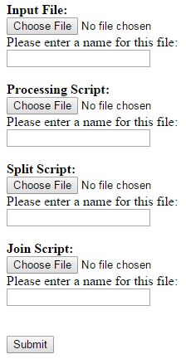
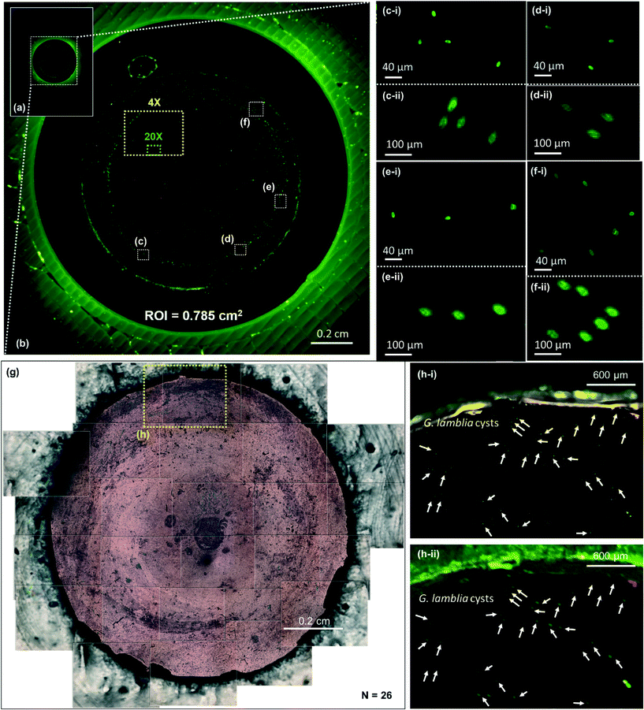
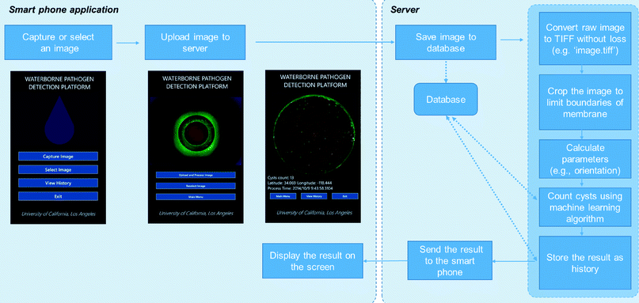
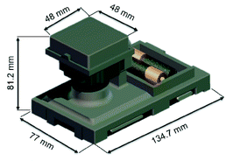
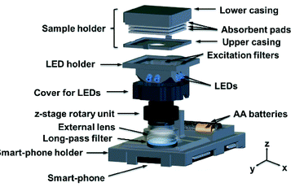













Rapid Automated Detection and Quantification of Giardia Lamblia Cysts
from Flourescent Images Using a Custom Distributed Image Processing System
Kyle Gronich, Zhao Yang, Steve Feng, Faizan Shabbir, Bingen Cortazar, Hatice Ceylan Koydemir, Aydogan Ozcan
Departments of Electrical Engineering and Bioengineering, University of California, Los Angeles, CA 90025 USA
Abstract and Introduction
Distributed System Overview
Results (cont’)
Rapid automated analysis of biomedical images is a computationally costly and time-consuming task. We aim to create a high-throughput distributed processing system that is able to dramatically decrease the time-cost for completing such processing tasks by distributing them across any number of computational machines.
In this system, a central server first receives a processing request, consisting of a set of code files, following a custom-designed format, to run and input images and parameters, from a client via a custom-designed web interface. Each set of input files is divided and sent to a set of worker machines based off the requested RAM, CPU, and GPU requirements. After each worker finishes its specific task, the central server merges the result from each worker and returns the final result to the requestor. This system is implemented in Python using the Twisted framework to facilitate the transferring of files between the central server and each worker.
We initially demonstrate the ability of this system by decreasing the time-cost to detect and quantify Giardia lamblia cysts captured on a membrane in fluorescent images taken from a custom-developed mobile-phone-based fluorescent microscope system. By distributing the processing for the MATLAB scripts, we demonstrate up to a 30% improvement compared to using a single worker machine. We aim to continue to improve the throughput of our system, increase the supported programming languages, and enable automated code reorganization for distributed processing.
The Twisted framework is built around asynchronous, callback-programming. Instead of blocking, functions can immediately return, and a callback chain will subsequently begin once data is available.
The system utilizes a custom protocol implemented on top of TCP.
Currently, the central server is running Linux while each worker machine is running Windows.
The central server, running its own custom-built Python program, acts as a proxy to an incoming request from the client. It is responsible for splitting the request, sending off tasks to the workers, and merging results.
A separate custom Python program is replicated on each worker to execute any given processing script, and send the results back to the central server.
Client’s Web Interface
(b) is the image of the filter membrane taken using our smartphone based fluorescent microscope, while (g) is taken using a 4× objective lens and a benchtop Olympus microscope under bright field illumination for comparison.
All of the (i) images are taken using objective lens and a benchtop microscope, while all of the (ii) images are digitally cropped images taken using the smartphone based fluorescence microscope for the same region of interest.
The comparison between (b) and (g) shows the large FOV of our fluorescent microscope compared to a standard benchtop microscope.
(c), (d), (e), (f), and (h) show that our fluorescent microscope accurately depicts the position of the G. lamblia cysts.
Giardia Detection Platform
Results
For our testing, we used an image with 10 Giardia lamblia cysts captured on the membrane.
 | 2 Workers | 3 Workers
Time to Split | 6.39 seconds | 6.75 seconds
Time to Process (max) | 25.48 seconds | 19.27 seconds
Time to Join | 5.79 seconds | 5.80 seconds
Total Time | 40.40 seconds | 34.88 seconds
The smartphone-based Giardia detection platform is a biomedical application, which detects and quantifies Giardia lamblia cysts, a waterborne parasite commonly found in polluted water sources.
Total time to process same input on one machine was about 63 seconds.
2 workers resulted in about a 36% improvement compared to a single machine.
3 workers resulted in about a 45% improvement compared to a single machine.
Acknowledgements
Built using a hardware attachment on a Nokia Lumia 1020, it captures an image of a processed water sample and marks potential Giardia cysts in that image using a machine learning-based detection method.
The detection platform is highly portable and has a complex structure.
We thank the Howard Hughes Undergraduate Research Program for their funding and support .

